Slide 1
Image processing using deep learning

Slide 2
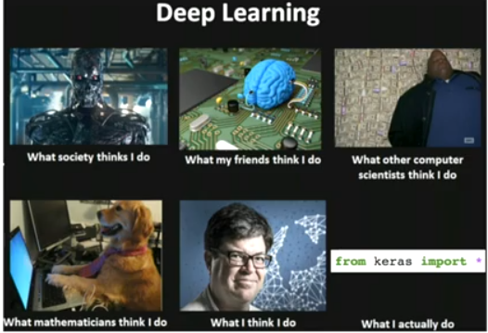
Deep learning

Slide 3
Deep learning workflow
Define problem
Assemble dataset
Choose measure of success
Decide evaluation protocol
Prepare your data
Develop a mode
Iterate models

Slide 4
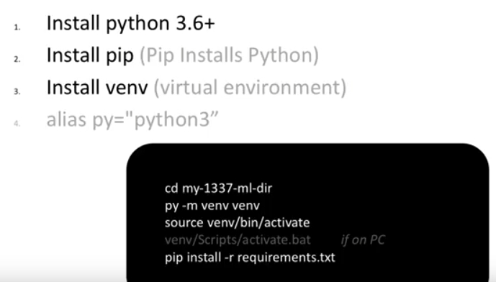
For exercises

Slide 5
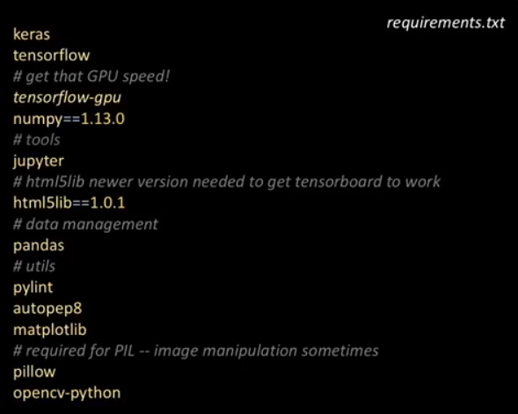
Requirements for CNN exercise
Check if GPU is enabled in your machine

Slide 6
Deep learning vocabulary
Layers
Tensors
Gradient descent
Optimizer
Loss
Activation
Overfitting
Back propagation
Epoch

Slide 7
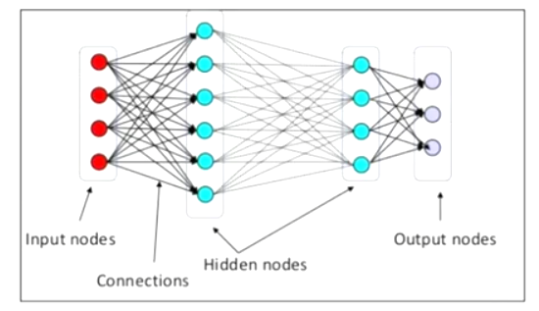
What is deep learning
It’s a neural network with > 1 hidden layer

Slide 8
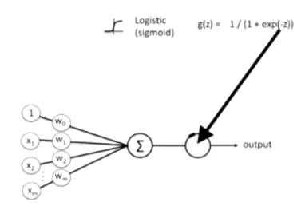
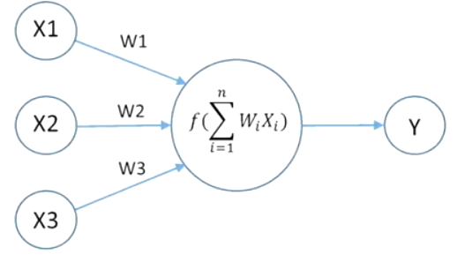
What individual node does
Activation brings non-linearity
At inflection point the input output mapping changes drastically

Slide 9
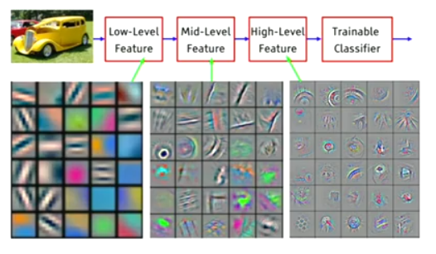
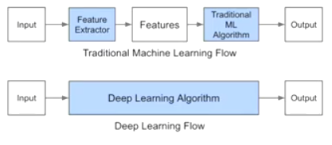
Why deep learning
It has great ways to capture underlying patterns in the data
More level of feature abstraction as we go deeper

Slide 10

TensorFlow
Can be thought of a complex container object that can contain any n dimension vector
These object can flow through a connected graph

Slide 11
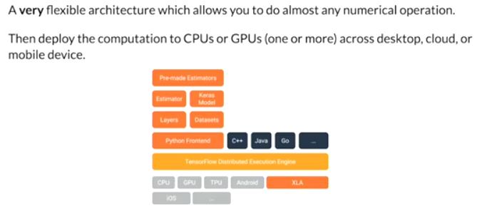
TensorFlow as a backend

Slide 12
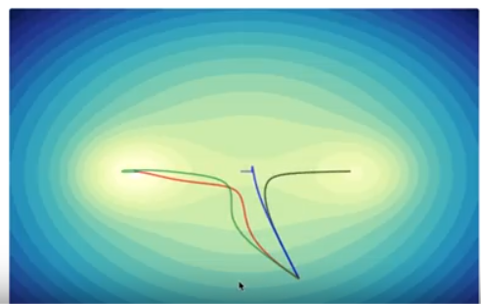
Optimization algorithm
Choosing different hyper parameter can end very different result, if multiple valleys exist in the loss function

Slide 13
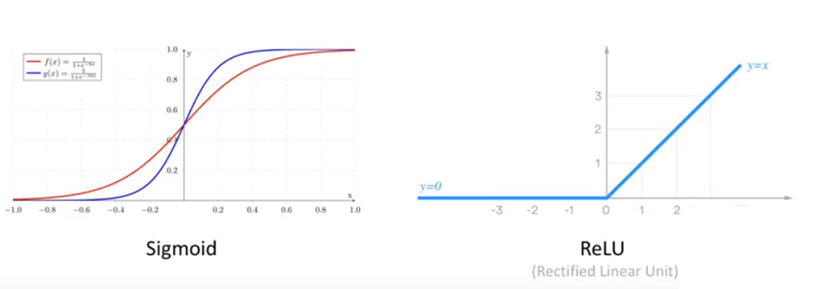
Activation function
Defines how much the neuron will fire based on the input

Slide 14
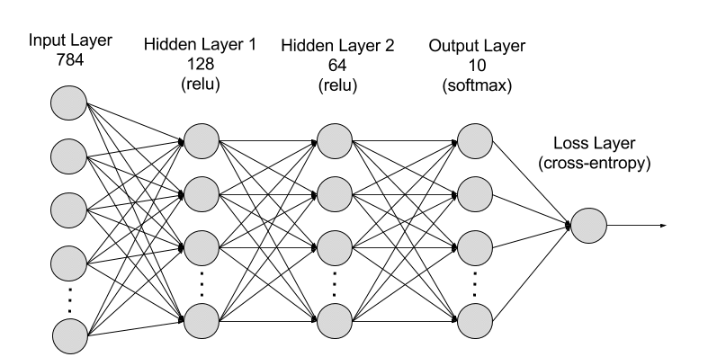
Dense neural network

Slide 15

Convolutional neural network

Slide 16
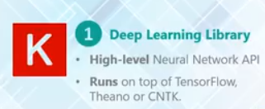
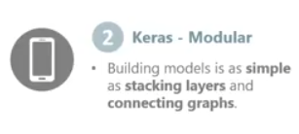

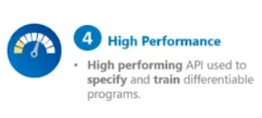
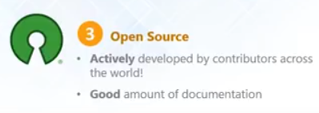
Keras

Slide 17
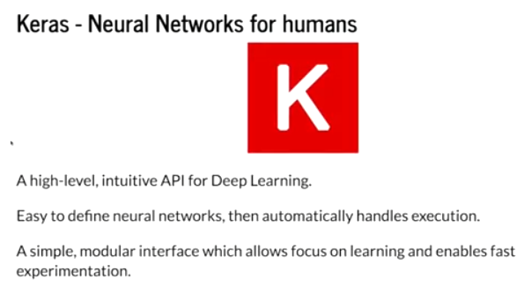
So, what is Keras?

Slide 18
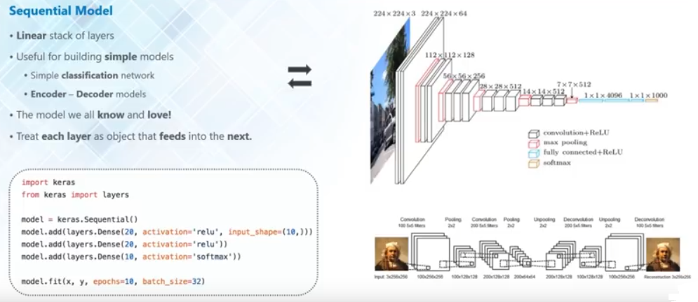
Keras sequential model

Slide 19
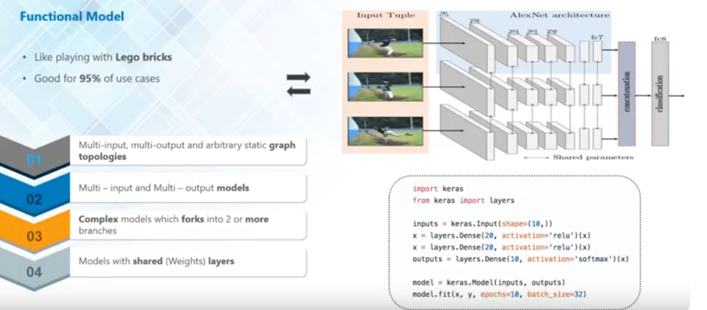
Keras functional model

Slide 20
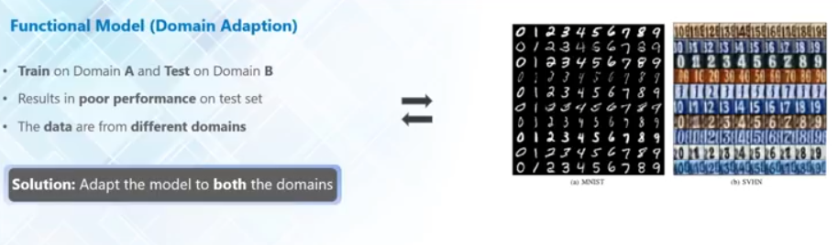
Domain adaptation

Slide 21
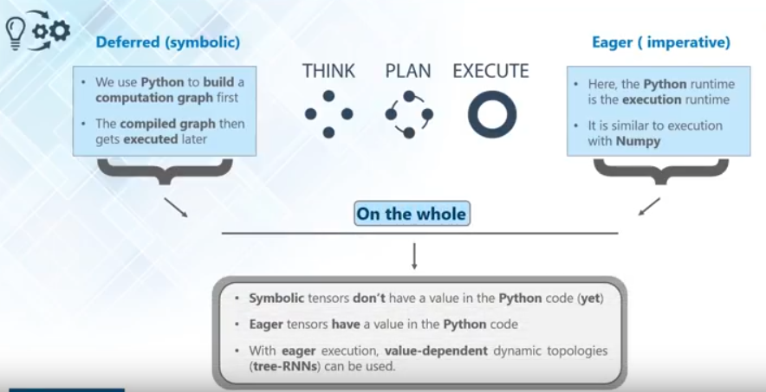
Two types of execution

Slide 22
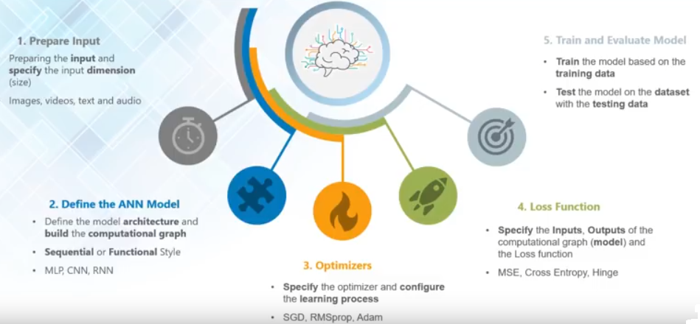
Implementing a network

Slide 23
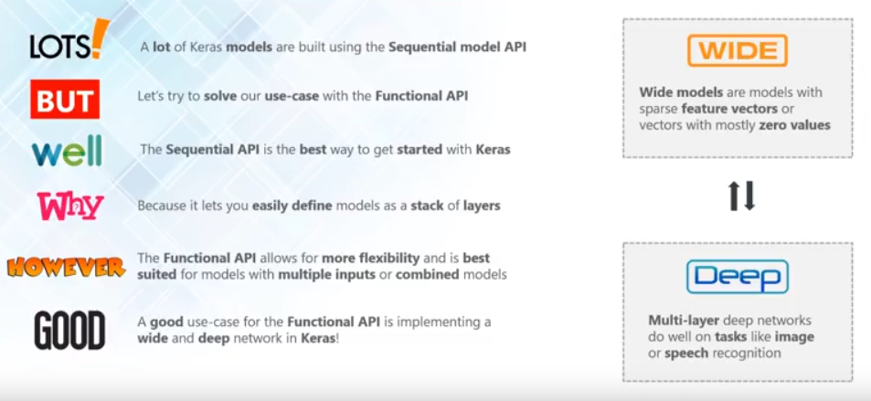
Important points to note for Keras use case

